Slide 1
How to temporarily change all items of a library or institution to be not for loan and not requestable
Yoel Kortick
Senior Librarian

Slide 2
Introduction
Identify the relevant fulfillment unit(s)
Identify or create a TOU for not for loan
Identify or create a TOU for not requestable
Create a Fulfillment Unit Rule for no loans allowed
Create a Fulfillment Unit Rule for not requestable
Disabling the loan and request limitations

Slide 3
Introduction

Slide 4
Introduction
There may be an unexpected situation in which for a certain undefined period of time the library needs to make all items not for loan and not requestable.
This may include all libraries of the institution, or a subset, such as certain libraries and / or certain locations.
This presentation will show how this may be done, and how the situation may be “turned back to normal” when the undefined period of time is over.

Slide 5
Introduction
The overall steps are:
Decide which libraries and locations you want to turn off loans and requests for
Make or find existing TOUs (Terms of use) which do not allow loans and request.
Use the TOUs to make fulfillment unit rules for turning off the loans and requests
Apply the rules
Disable the rules when it is “all over” so everything goes “back to normal”.

Slide 6
Identify the relevant fulfillment unit(s)

Slide 7
Identify the relevant fulfillment unit(s)
Each fulfillment unit contains one or more libraries and their locations.
In some cases the institution has only one fulfillment unit containing all libraries and their locations.
If you do not want to make the change for all libraries and their locations then you will first need to identify the relevant fulfillment unit(s).
You can also make the rules for multiple fulfillment units.

Slide 8
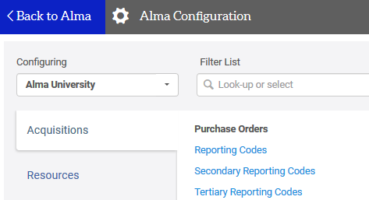
Identify the relevant fulfillment unit(s)
In the configuration menu be sure that you are configuring for the institution.
In this case the institution is “Alma University”

Slide 9
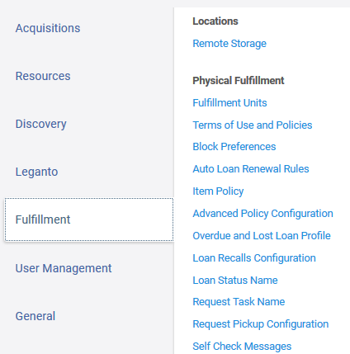
Identify the relevant fulfillment unit(s)
Under “Fulfillment > Physical Fulfillment” choose “Fulfillment Units”

Slide 10
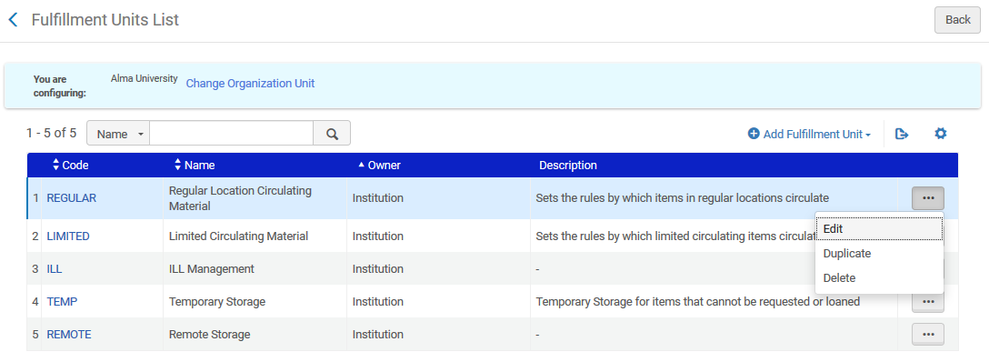
Identify the relevant fulfillment unit(s)
Here are our “Fulfillment Units”. We will edit the “Regular Location Circulating Material” to see which locations it includes

Slide 11
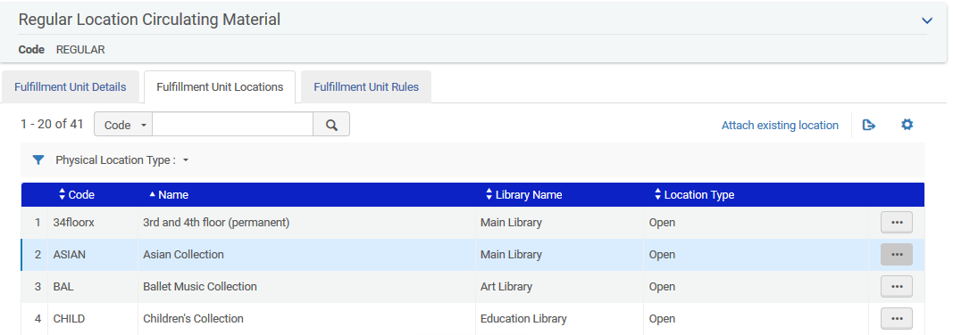
Identify the relevant fulfillment unit(s)
We see the libraries and locations included in the Fulfillment Unit “Regular Location Circulating Material”.

Slide 12
Identify the relevant fulfillment unit(s)
We will now make all items in the locations of the Fulfillment Unit “Regular Location Circulating Material” be “Not for loan” and “Not requestable”.

Slide 13
Identify or create a TOU for not for loan

Slide 14
Identify or create a TOU for not for loan
It is most likely that the institution already has a Terms of Use (TOU) for items to be “Not for loan” and “Not Requestable”.
We need to identify this TOU or create a new one.

Slide 15
Identify or create a TOU for not for loan
Under “Fulfillment > Physical Fulfillment” choose “Terms of Use and Policies”

Slide 16
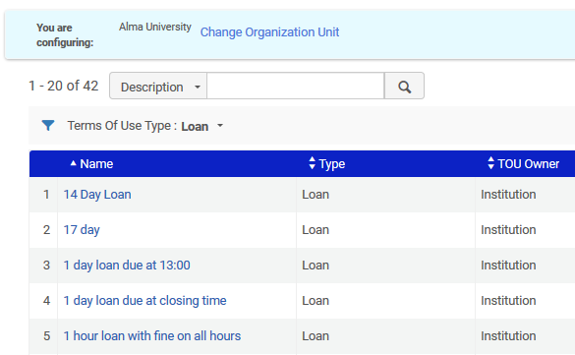
Identify or create a TOU for not for loan
Here are the TOUs filtered by type “Loan”

Slide 17
Identify or create a TOU for not for loan
There are two choices here: find an existing TOU which does not allow loans or create a new one.
We will create a new one and call it “Not for loan”

Slide 18
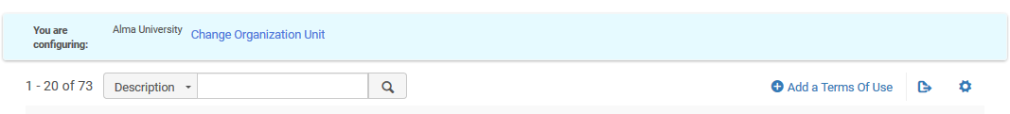
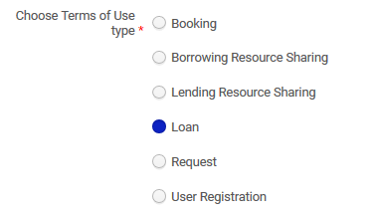
Identify or create a TOU for not for loan
Add a terms of Use

Slide 19
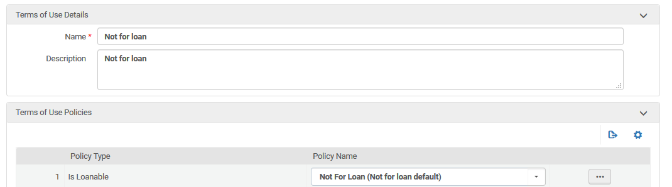
Identify or create a TOU for not for loan
Add a terms of Use
Defined as “not for loan”

Slide 20
Identify or create a TOU for not requestable

Slide 21
Identify or create a TOU for not requestable
Under “Fulfillment > Physical Fulfillment” choose “Terms of Use and Policies”

Slide 22
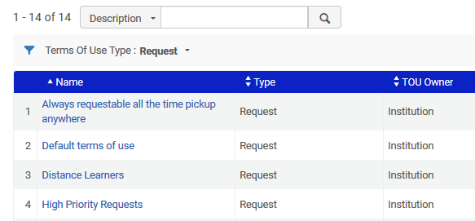
Identify or create a TOU for not requestable
Here are the TOUs filtered by type “Request”

Slide 23
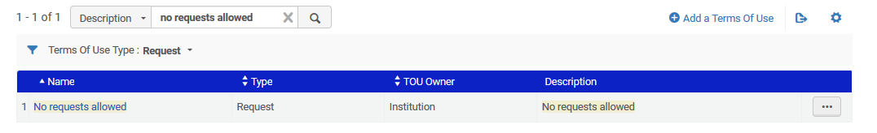
Identify or create a TOU for not requestable
There are two choices here: find an existing TOU which does not allow requests or create a new one.
We already have one called “no requests allowed”

Slide 24
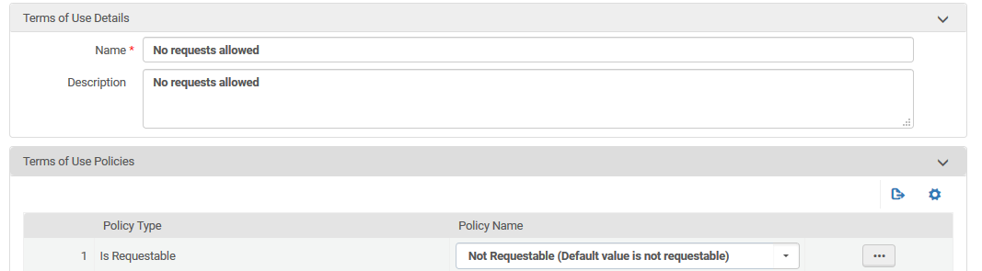
Identify or create a TOU for not requestable
An existing terms of Use
Defined as “not requestable”

Slide 25
Create a Fulfillment Unit Rule for no loans allowed

Slide 26
Create a Fulfillment Unit Rule for no loans allowed
Now we will create a fulfillment unit rule for “No Loans Allowed”.
It will use the TOU “Not for loan”
It will have no conditions (so it will always apply)
It will be first in the list (so it will always be used)

Slide 27
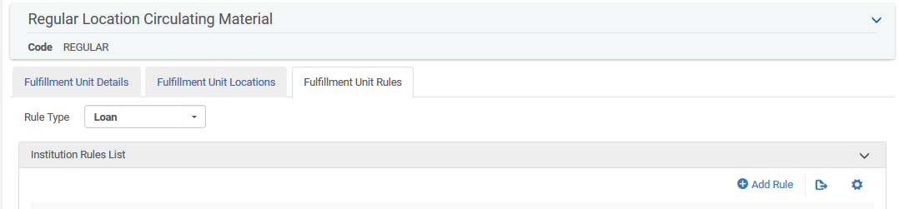
Create a Fulfillment Unit Rule for no loans allowed
In the Fulfillment Unit “Regular Location Circulating Material” switch to the “Fulfillment Unit Rules” tab and add a rule for “No Loans Allowed”.

Slide 28
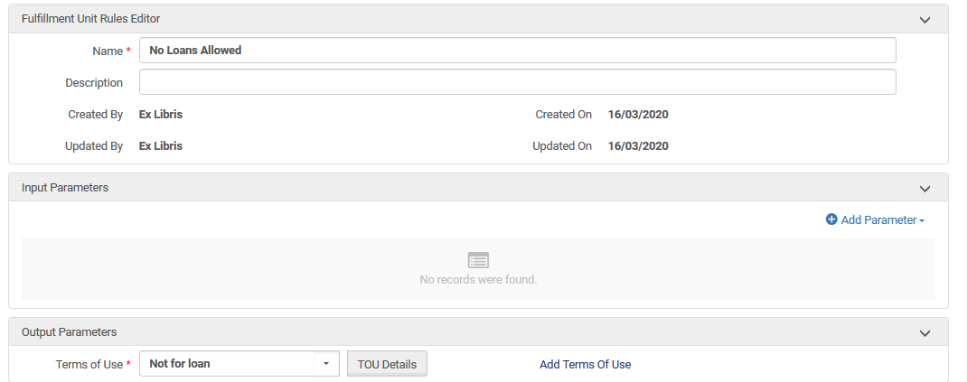
Create a Fulfillment Unit Rule for no loans allowed
No conditions
The TOU which does not allow loans

Slide 29
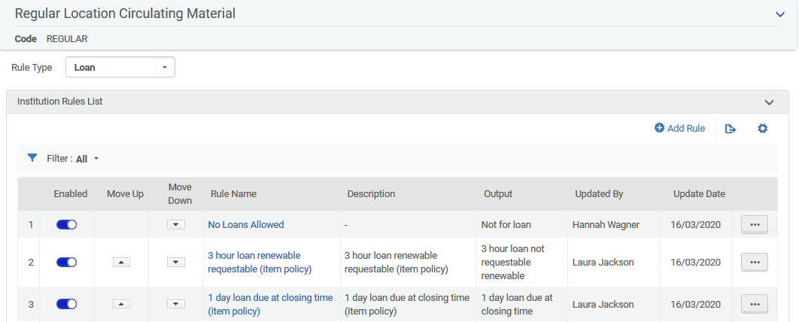
Create a Fulfillment Unit Rule for no loans allowed
Put the new Fulfillment Unit Rule first in the list

Slide 30
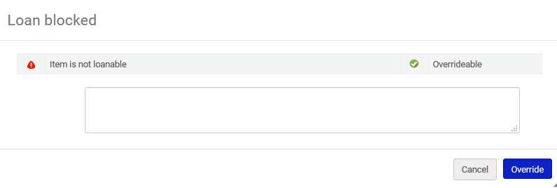
Create a Fulfillment Unit Rule for no loans allowed
Try to loan an item which was previously loanable and see that now it cannot be loaned

Slide 31
Create a Fulfillment Unit Rule for not requestable

Slide 32
Create a Fulfillment Unit Rule for not requestable
Now we will create a fulfillment unit rule for “Not requestable”.
It will use the TOU “No requests allowed”
It will have no conditions (so it will always apply)
It will be first in the list (so it will always be used)

Slide 33
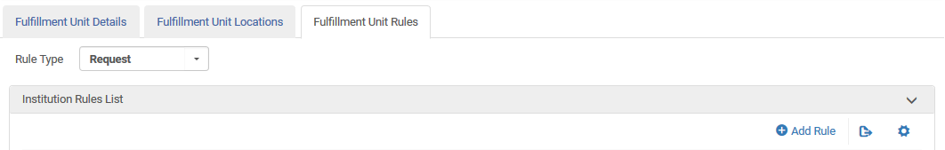
Create a Fulfillment Unit Rule for not requestable
In the Fulfillment Unit “Regular Location Circulating Material” switch to the “Fulfillment Unit Rules” tab and add a rule for “Not requestable”.

Slide 34
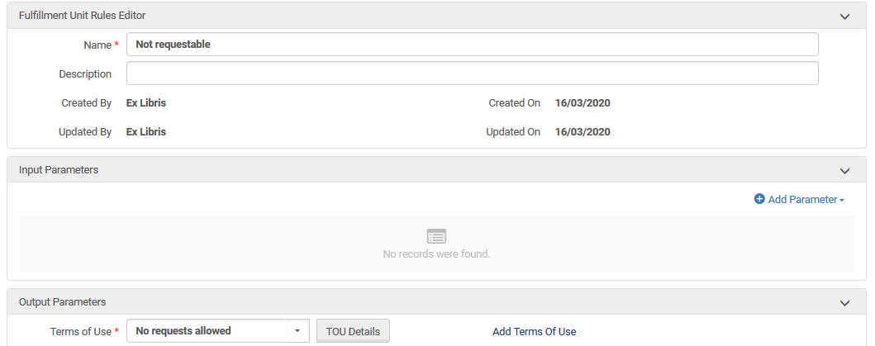
Create a Fulfillment Unit Rule for not requestable
No conditions
The TOU which does not allow requests

Slide 35
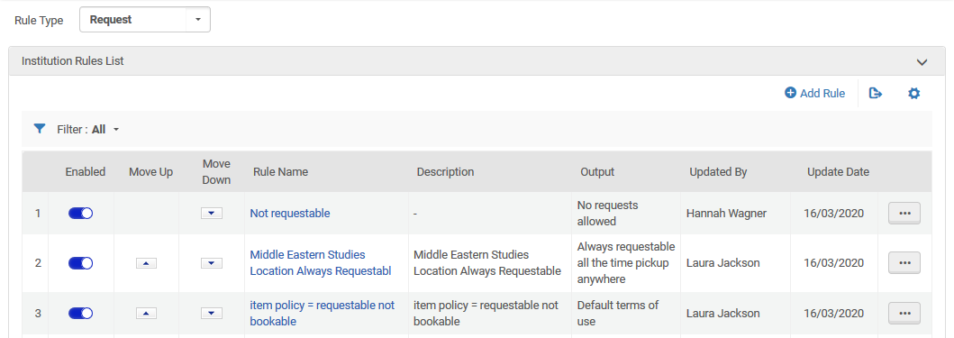
Create a Fulfillment Unit Rule for not requestable
Put the new Fulfillment Unit Rule first in the list

Slide 36
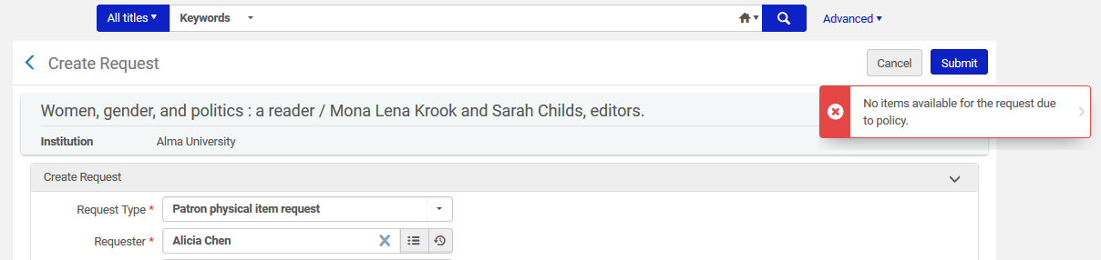
Create a Fulfillment Unit Rule for not requestable
Try to request an item which was previously requestable and see that now it cannot be requested. Here it is in Alma.

Slide 37
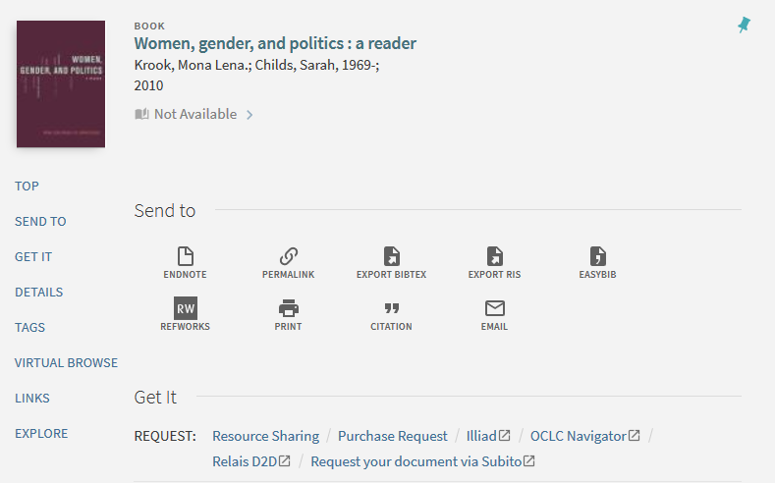
Create a Fulfillment Unit Rule for not requestable
Here it is in Primo
No link to “Request”

Slide 38
Disabling the loan and request limitations

Slide 39
Disabling the loan and request limitations
At the end of the “unspecified period of time” when the institution wants to return everything “back to normal” all they have to do is disable the two rules which were added. Now everything is as it previously was.

Slide 40
Thank you!
xxx@exlibrisgroup.com

